Slide 1
Introduction 2/2
Tools overview

Slide 2
Questions
What should we use to write our application?
How can we manage all our dependencies?
How will we bundle our app?
How can we test all our cool features?
What tool should we take for comfortable development?

Slide 3
SPA
Single page application is a web app that interacts with the user by dynamically rewriting the current page rather than loading entire new pages from a server. The page does not reload at any point in the process.

Slide 4
Pros of SPA
SPA is fast, as most resources (HTML+CSS+Scripts) are only loaded once throughout the lifespan of application. Only data is transmitted back and forth.
The development is simplified and streamlined. There is no need to write code to render pages on the server. It is much easier to get started because you can usually kick off development from a file file://URI, without using any server at all.
SPAs are easy to debug with Chrome, as you can monitor network operations, investigate page elements and data associated with it.
It’s easier to make a mobile application because the developer can reuse the same backend code for web application and native mobile application.
SPA can cache any local storage effectively. An application sends only one request, store all data, then it can use this data and works even offline.

Slide 5
Cons of SPA
It is slow to download because heavy client frameworks are required to be loaded to the client.
It requires JavaScript to be present and enabled. If any user disables JavaScript in browser, it won’t be possible to present application and its actions in a correct way. (Partially can be solved with server side rendering).
Compared to the “traditional” application, SPA is less secure. Due to Cross-Site Scripting (XSS), it enables attackers to inject client-side scripts into web application by other users.
Memory leak in JavaScript can even cause powerful system to slow down

Slide 6
PWA
Progressive Web App is a term used to denote web applications that use the latest web technologies. They can appear to the user like traditional applications or native mobile applications. The application type attempts to combine features offered by most modern browsers with the benefits of mobile experience.

Slide 7
What is framework
Framework is a universal, reusable software environment that provides particular functionality as a part of a larger software platform to facilitate development of software applications, products and solutions.

Slide 8
Frontend frameworks
Angular.js (1.x)
Marionette.js
Ember.js
Angular (2+)
React.js (boilerplate)
Vue.js

Slide 9

React (boilerplate)
A JavaScript library for building user interfaces
Declarative
Component-based
Learn once, write anywhere
(spa, node ssr, react native
for mobile apps)
Facebook

Slide 10

Angular
One framework. Mobile & desktop.
Develop across all platforms
Speed & performance
Incredible tooling
Google

Slide 11

Vue
The Progressive JavaScript Framework
Approachable
Versatile (ecosystem easy
to scale between library and
a full-featured framework)
Performant (20kb min+zip,
fast virtual DOM)
Alibaba uses it in production

Slide 12
Typescript
TypeScript is a typed superset of JavaScript that compiles to plain JavaScript. It adds optional static typing.
Existing JavaScript programs are also valid TypeScript programs.
Microsoft is a maintainer of it. First appeared in Oct 2012

Slide 13
Typescript types
function add(left: number, right: number): number {
return left + right;
}

Slide 14
Typescript classes
class Person {
private name: string;
private age: number;
private salary: number;
constructor(name: string, age: number, salary: number) {
this.name = name;
this.age = age;
this.salary = salary;
}
toString(): string {
return `${this.name} (${this.age})`;
}
}

Slide 15
Typescript features list
Type annotations
Classes
Interfaces
Enums
Generics
Async/await
Any feature of JS + some of JS proposals

Slide 16

Node.js
Node.js is an open-source, cross-platform JavaScript run-time environment for executing JavaScript code server-side.
It’s built on Chrome’s V8 JS Engine.

Slide 17

NPM
Npm is a package manager for the JavaScript programming language. It is the default package manager for the JavaScript runtime environment Node.js. It consists of a command line client, also called npm, and an online database of public and paid-for private packages, called the npm registry.

Slide 18

Webpack
Webpack is a module bundler for modern JavaScript applications. When webpack processes your application, it recursively builds a dependency graph that includes every module your application needs, then packages all of those modules into a small number of bundles - often only one - to be loaded by the browser.

Slide 19
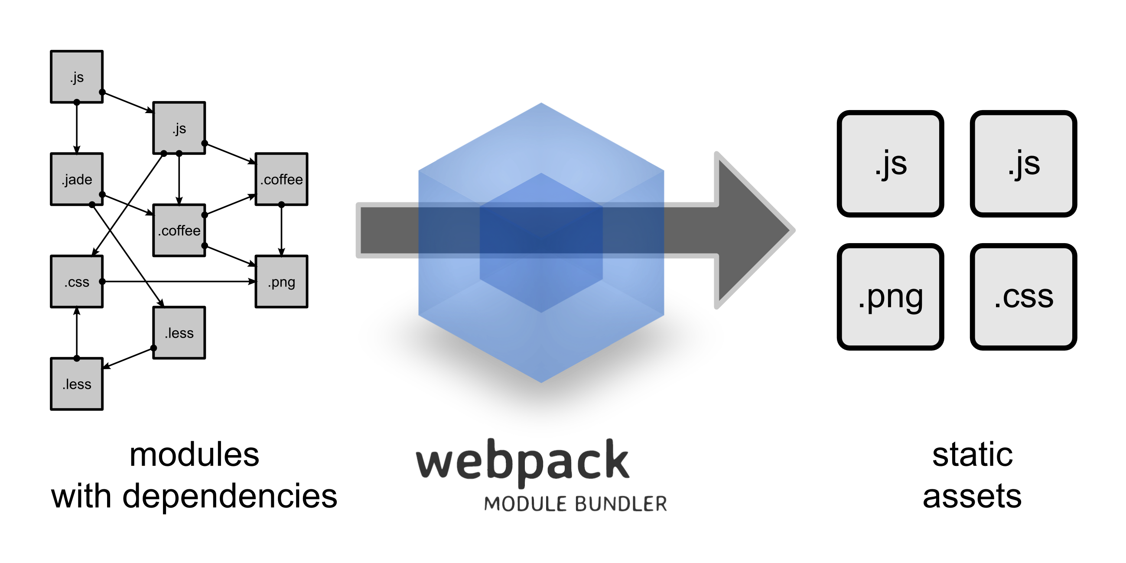
Webpack

Slide 20

Karma
Karma is not a testing framework, nor an assertion library. Karma just launches an HTTP server, and generates the test runner HTML file you probably already know from your favourite testing framework. It’s mostly used for unit testing.

Slide 21

Jasmine
Jasmine is a behavior-driven development framework for testing JS code.
It doesn’t depends on any other JS frameworks.
It also doesn’t require DOM.

Slide 22
Text editors, IDEs
Sublime Text 3
Atom
Visual Studio Code
WebStorm

Slide 23
Asynchronous JS
Callback
Promise
Async/await
Event loop

Slide 24
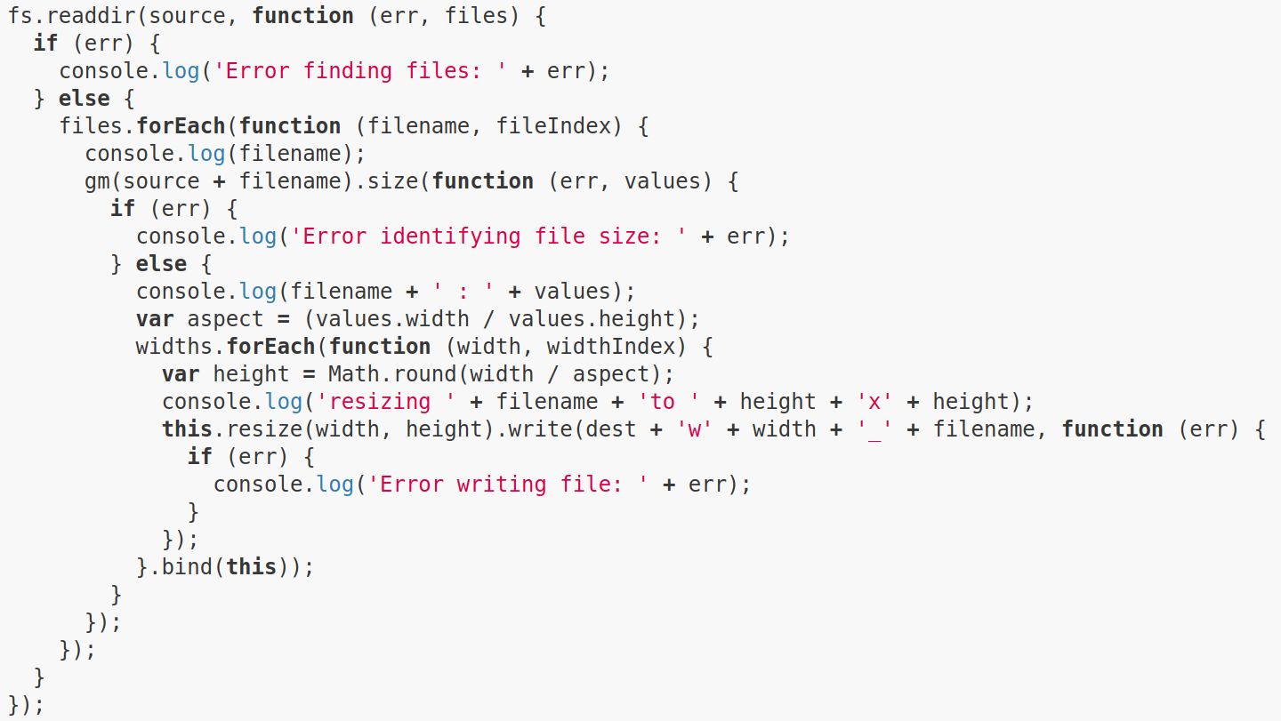
Callback hell

Slide 25
How to avoid it?
Keep your code shallow
Modularize (make your own small “libraries”)
Handle every error (e.g. preserve first arg for error object)

Slide 26
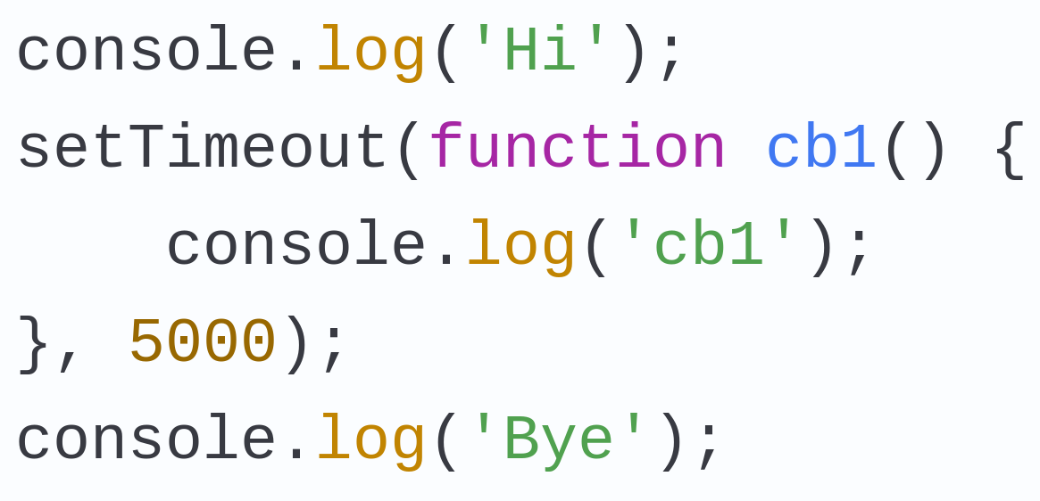
Event loop

Slide 27
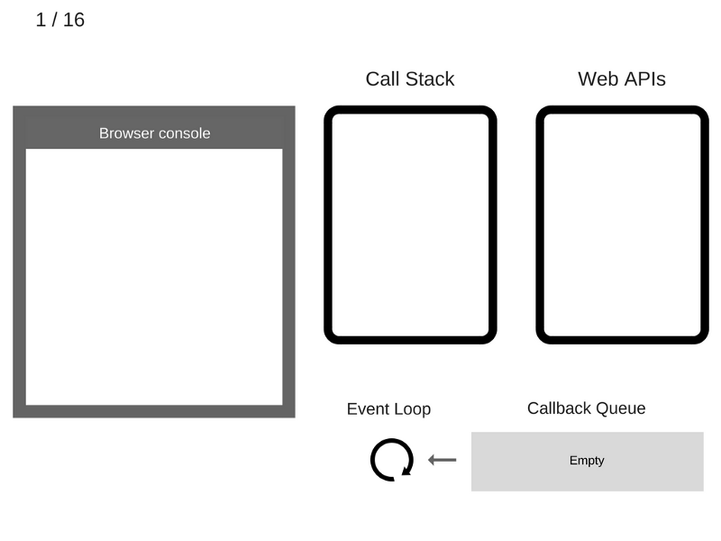

Slide 28
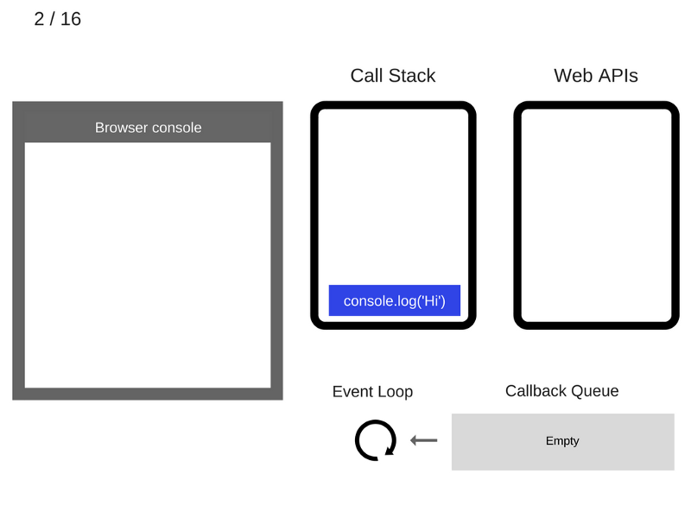

Slide 29


Slide 30


Slide 31


Slide 32
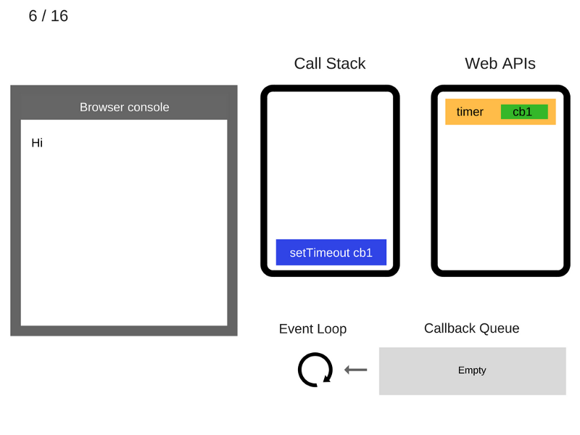

Slide 33
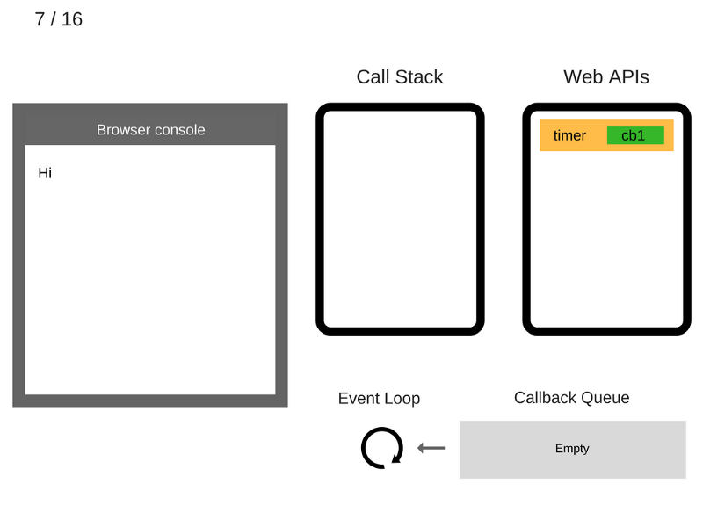

Slide 34


Slide 35
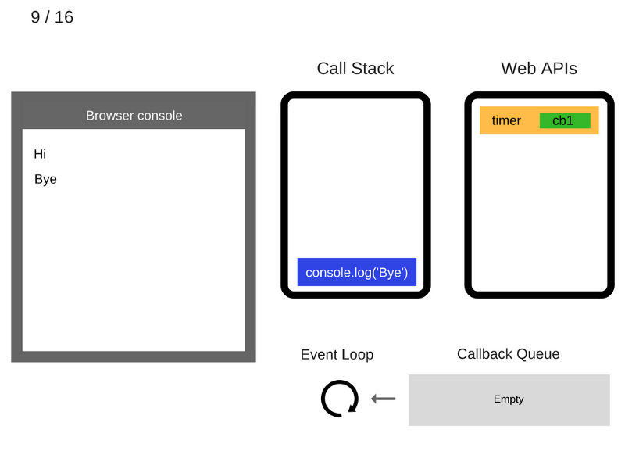

Slide 36


Slide 37
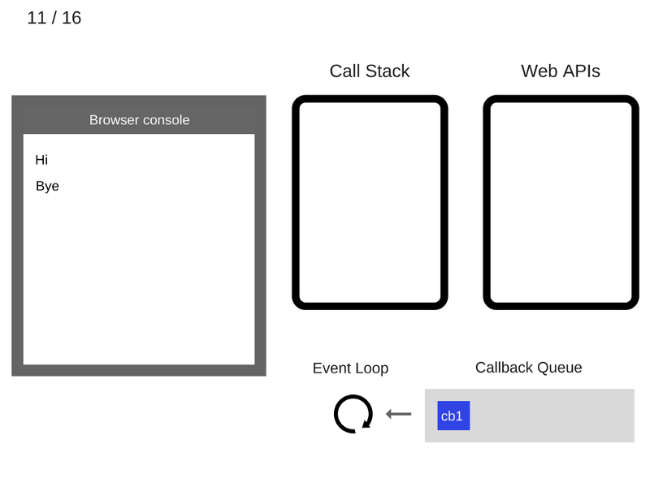

Slide 38


Slide 39
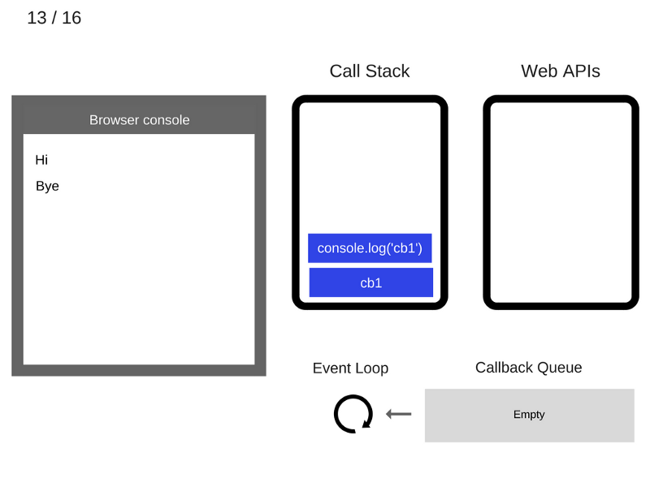

Slide 40


Slide 41


Slide 42
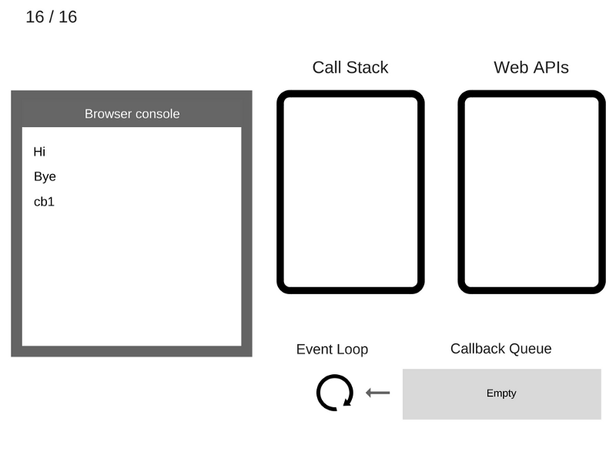

Slide 43
Q&A

